Slide 1
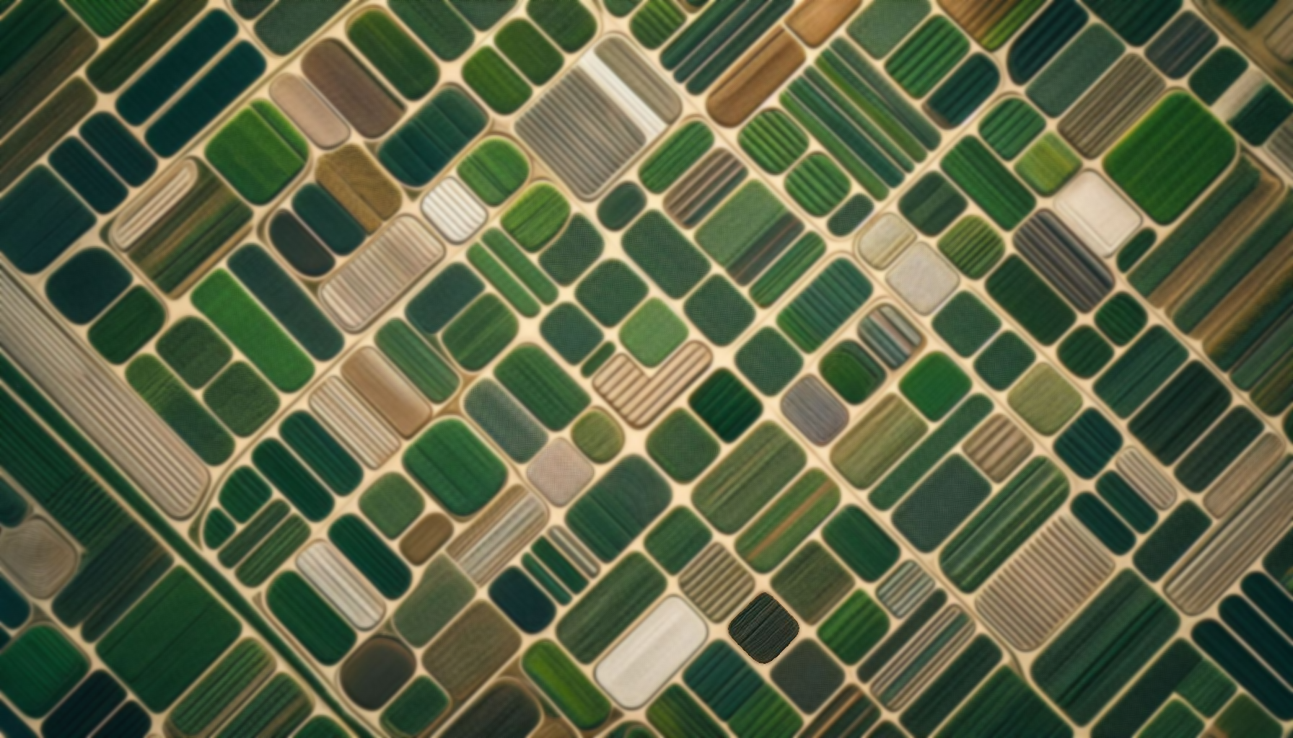
BTP-II Presentation: Segmentation of Agricultural Crop Fields
Raavi Gupta
Guide: Prof. V. Rajbabu

Slide 2
Outline
Introduction
NDVI
Problem Setup
Literature review
Approach
Results

Slide 3
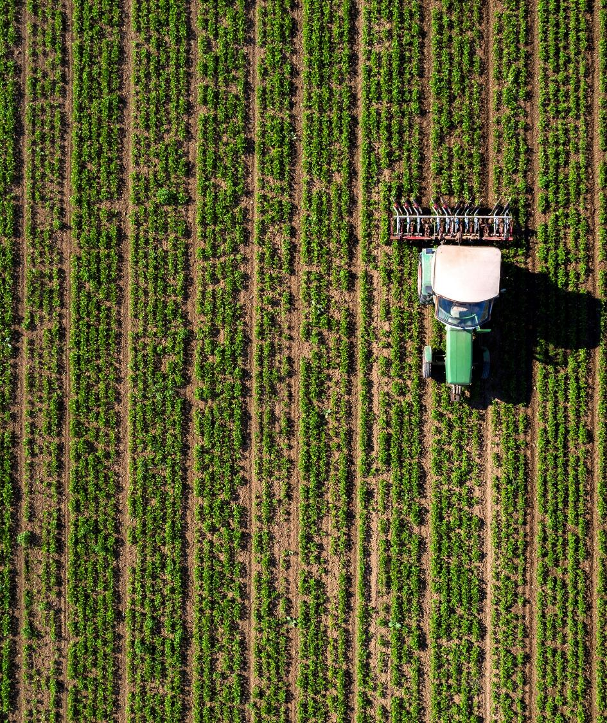
Introduction

Slide 4
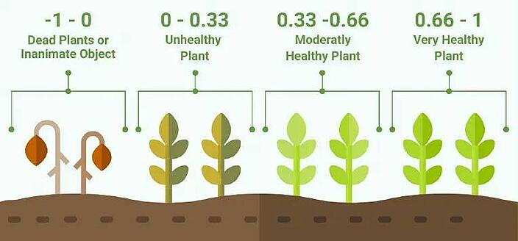
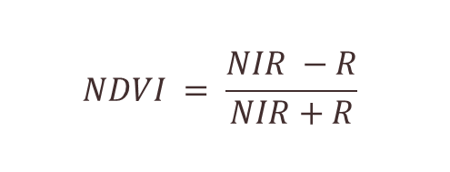
NDVI is an indicator to differentiate the treatment given to various soil patches
NDVI
The normalized difference vegetation index (NDVI) is a widely-used metric for quantifying the health and density of vegetation using sensor data. It is calculated from spectrometric data at two specific bands: red and near-infrared.
$$NDVI = \frac{NIR −R}{NIR+R}$$
NIR: Near-Infra red band value
R: Red band value
Image Source: https://www.cropin.com/blogs/ndvi-normalized-difference-vegetation-index
Notes:
Plants have a unique reflectance characteristic, they reflect more near-infrared (NIR) light and absorb more visible light. When plants are healthy, they have a high chlorophyll content, which allows them to absorb more light in the red region of the spectrum and reflect more light in the NIR region. So NDVI uses this characteristic of plants to differentiate healthy vegetation from non-vegetation or unhealthy vegetation.

Slide 5





Patch-wise NDVI calculation is difficult in the absence of labeled data for supervised segmentation
Lack of labeled data hinders supervised segmentation
Input:
Alignment
Segmentation
RGB + NIR + Red-Edge + Panchromatic
Aligned RGB
Segmented mask
NDVI, NDRE, NGRDI, BGI, and so on ...
Segmented mask
Aligned NIR
Aligned Red

Slide 6
Literature review

Slide 7
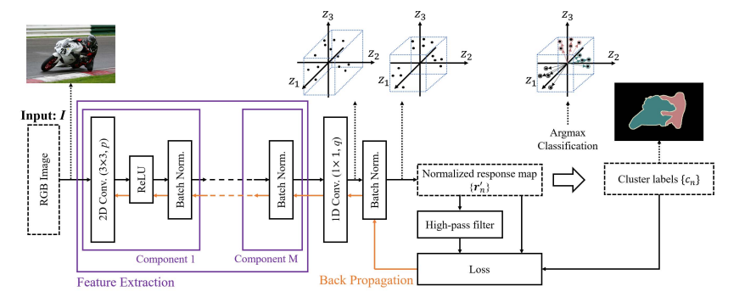
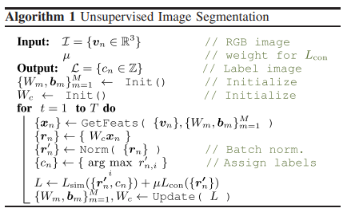
Hence, the focus was on unsupervised algorithms to compensate for the lack of labeled data
Unsupervised Learning of Image Segmentation Based on Differentiable Feature Clustering¹
Pixels of similar features are desired to be assigned the same label
Spatially continuous pixels are desired to be assigned the same label
The number of unique labels is desired to be large

Slide 8
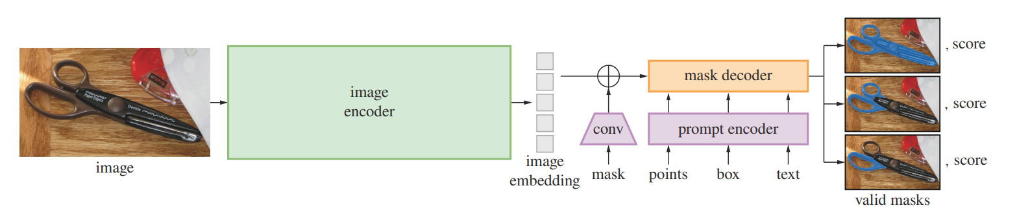
SAM – Segment Anything² is the current state-of-the-art method for unsupervised segmentation
Trained on the largest open-source masks dataset
Prompt can be text or the bounding boxes
Automatic segmentation can also be provided
Semi-automatic training data collection paradigm

Slide 9
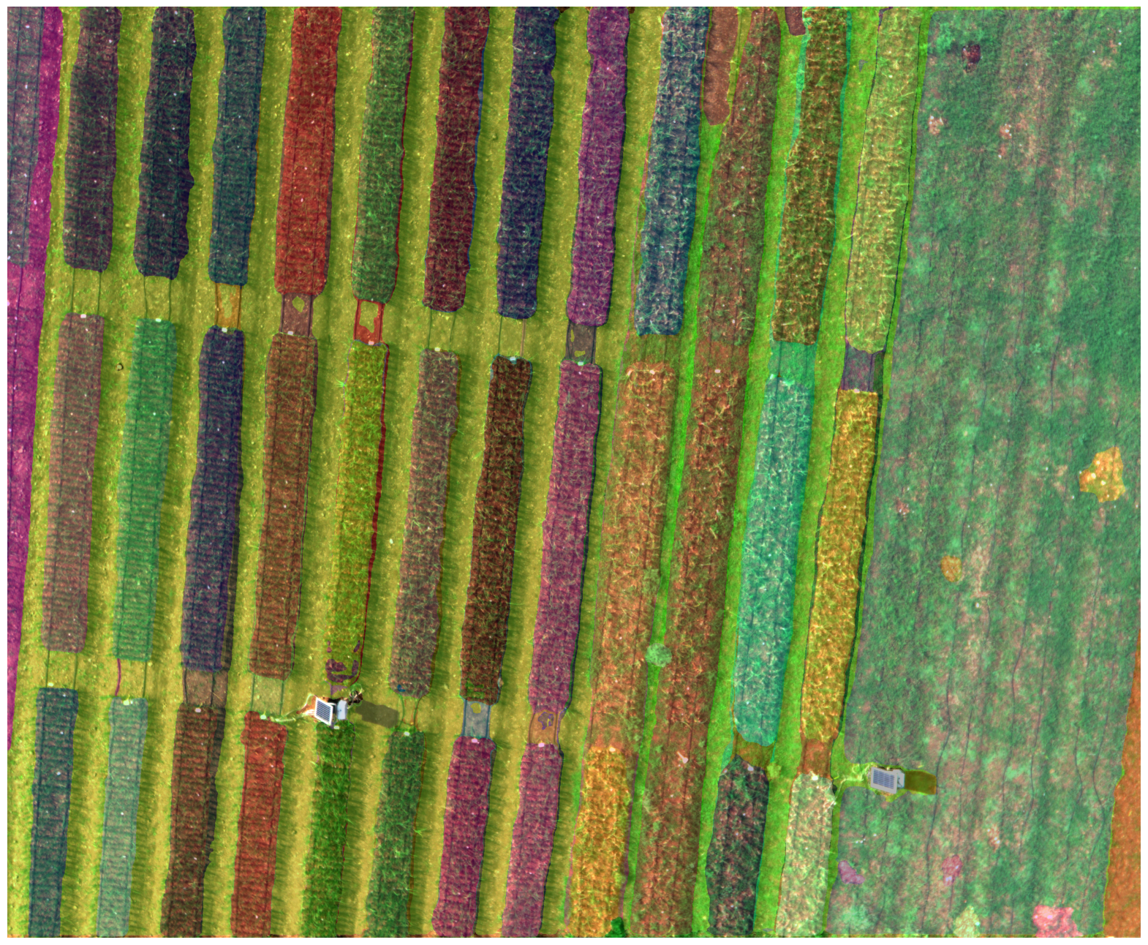
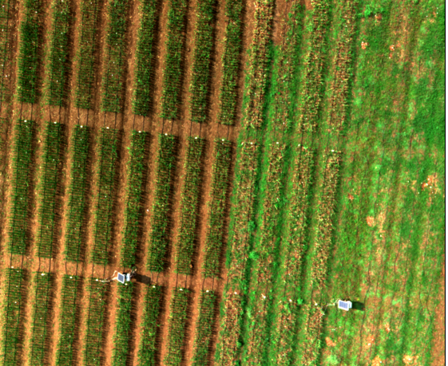
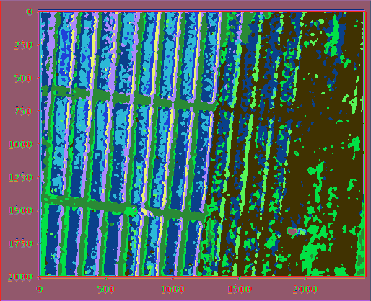
Qualitatively, SAM seems to be performing better than common unsupervised methods on our data
SAM
Original (aligned) RGB
Differentiable Feature Clustering
SAM requires minimum human intervention as opposed to differentiable feature clustering (have to provide the number of clusters).
Well segregated masks of SAM as compared to differentiable clustering

Slide 10
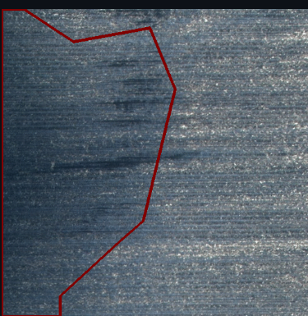
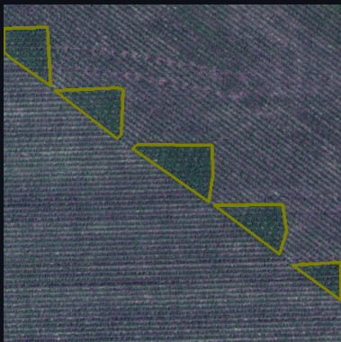
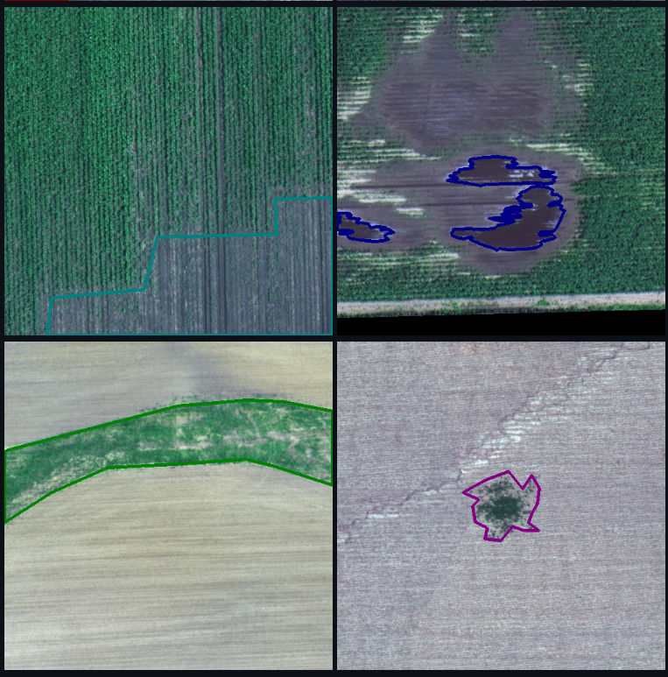
However, to benchmark SAM’s performance a quantitative analysis was done on a standard dataset
Dataset: Agrivision-Dataset
Challenge hosted every year
Ten labels
Background
Waterway
Weed cluster
..
Aerial farmland images
Train: 56,944 Images
Test: 19,708 Images
Challenge runner-up: MSCG-NET³
Source: Agrivision-dataset

Slide 11
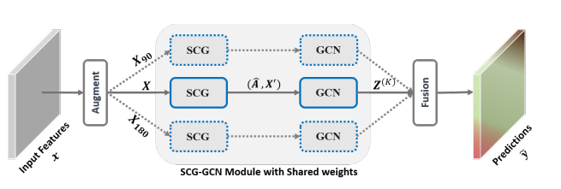
Multi-view Self-Constructing Graph (SCG) Convolutional Networks³ is the runner-up in the latest challenge for the dataset
1. SCG learns to transform a 2D feature map into a latent graph structure and assign pixels (X ′) to the vertices of the graph (Aˆ).
2. GCN is then exploited to update the node features along the edges of graph.
3. The combined module of SCG and GCN (SCG-GCN) can takes augmented multi-view input features
4. The updated multi-view representations are fused and projected back onto 2D maps.

Slide 12
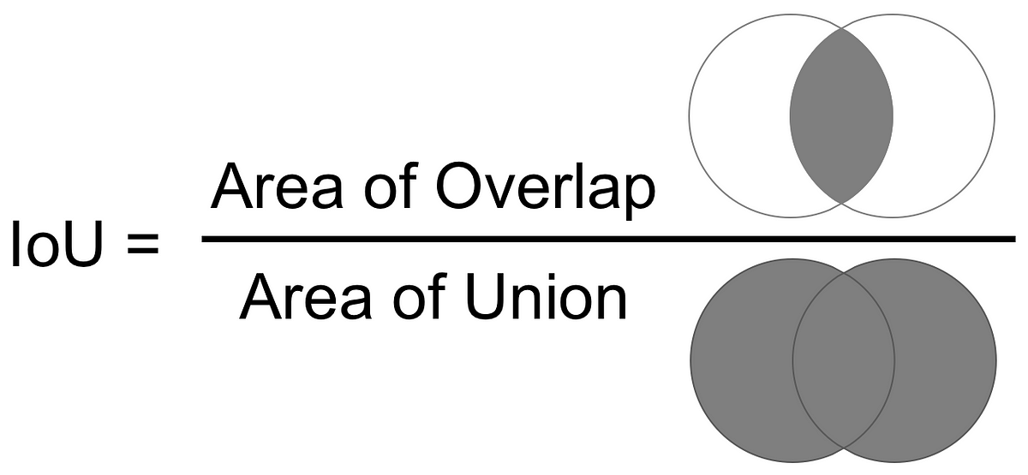
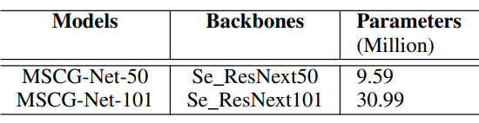
SAM performs at-par with MSCG-Net thus giving a quantitative assurance
M-IOU scores | MSCG-Net-101 | SAM-default
test | 0.33 | 0.72
test-upsampled | N.A. | 0.72
test-downsampled | N.A. | 0.74
The final model of MSCG-NET comprises of an ensemble of MSCG-Net-101 and MSCG-Net-50
Therefore, the results can be underwhelming
To save computational resources, the model was trained on only for MSCG-Net-101 on a dgx

Slide 13
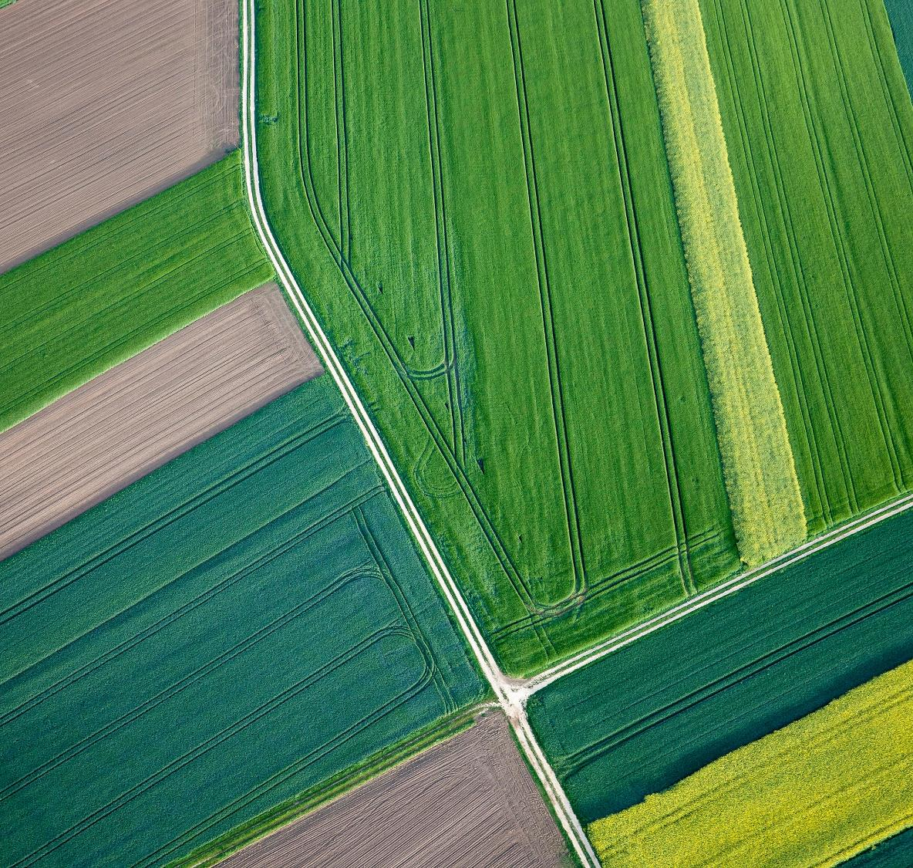
NDVI with SAM

Slide 14
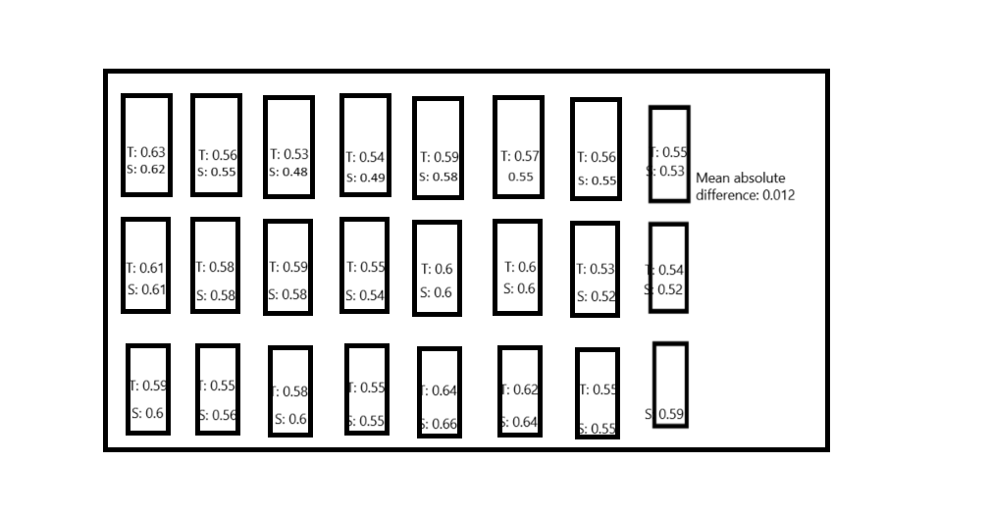
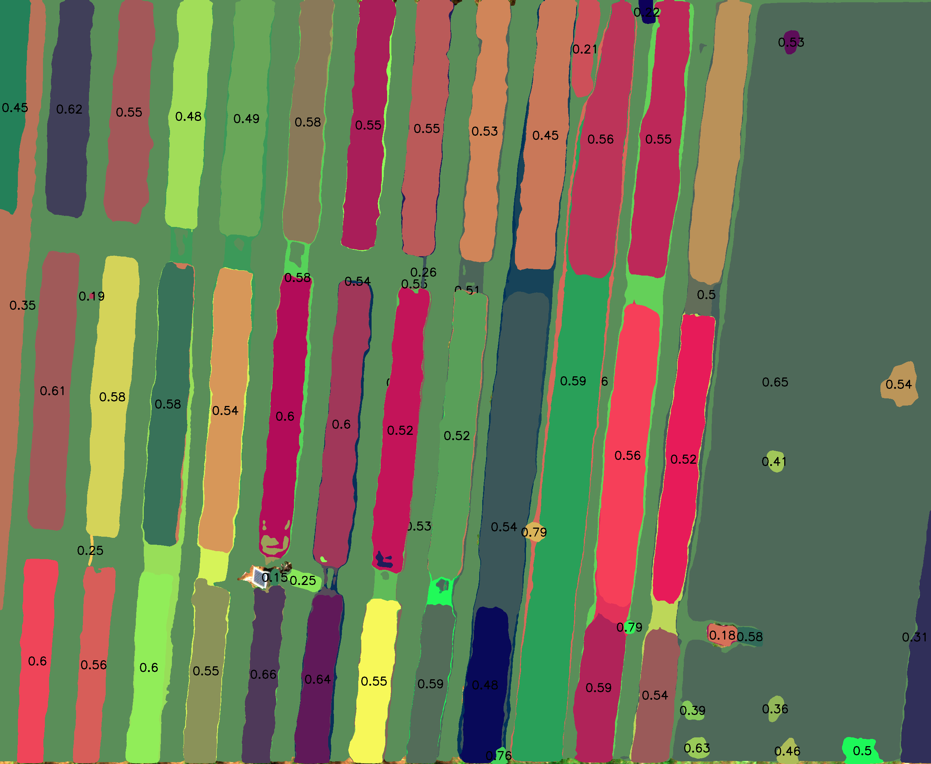
NDVI + SAM give good results and matches the output of pix4d mapper
S: Segmentation with SAM
T: Segmentation with thresholding (image-specific threshold)

Slide 15
Other work done
Literature review on Canopy height estimation from drone images
Detection of crop-rows solely on the basis of lines present in them by using Hough transform

Slide 16
Future directions
Test the pipeline on a different custom dataset
Work on canopy height estimation
Optical and LIDAR data might help
Semi-supervised method: If NDVI values are available then we can create a 1D convolution to merge the four bands and then pass it through SAM.
Fine-tuned SAM on AgriDataset

Slide 17
Ending notes
I’d like to thank Prof. V. Rajbabu for providing me the opportunity to contribute to this exciting project. I’d also like to thank him for his constant support and prompt clarifications to problems I faced.

Slide 18
Thank you!

